Slide 1
Design Presentation: Spark and ML
Owner:
CS | 1 of 2
Session Day/Time: |  | Presenters/SMEs:
Virtual Format and Software:
Cohort / Breakout Mgmt
Objective of Session: | As a result of attending this, attendees will better be able to…
Existing Sources: | <link to any supporting content sources (if any)>
Learner Content: | <Link to draft ppt slide deck and any other materials that the attendees would be seeing or using as part of this session>
Presenter/ SME Guide Content: | <Link to any supporting materials that are just for the presenter and/or supporting SMEs>
Required Homework + name of session for HW review: | No homework or pre-required content needed for this session

Slide 2
Design Presentation: Spark and ML
Owner: Sean Norman
CSA07P | 2 of 2
Session Flow and Detailed Agenda |  | Presenter/SME: | Time
Prework | No attendee pre-work needed for this session | N/A | N/A
Session Introduction | Set context for when this process takes place | <presenter> | 3 mins
Body of the session / discussion, activities, Q&A... |  | <presenter> | 25 mins
Session Closing / Homework |  | <presenter> | 2 mins

Slide 3
Topics Covered
Spark and Machine Learning
The Data Science Process
Spark
Machine Learning

Slide 4
Spark and Machine Learning in Azure Synapse

Slide 5

Agenda
1 The Data Science Process
Key components of the data science process
2 Spark
Apache Spark in Synapse Analytics use cases
3 Machine Learning
Machine Learning in Azure Synapse Analytics

Slide 6
The Data Science Process

Slide 7
Introducing the Data Science Process
As the data environment changes and affect model performance, retrain the model on fresh data
Developer Lens
Re-train
Model
Collect Data
Prepare Data
Train Model
Evaluate Model
Deploy Model
Write Code
Write Queries & Code
Write Code Do some math
Write Code Do some math
Do DevOps
Perform data wrangling to get the data in a format suitable for analysis
Explore and understand the data
Identify or create the features needed for your model
Select the algorithm
Prepare training, testing and validation data sets
Iteratively evaluate model to identify best performing version and sanity check outcome
Select the algorithm
Prepare training, testing and validation data sets
Iteratively evaluate model to identify best performing version and sanity check outcome
Package the model and dependencies up for deployment
Use it in a web service or within an API in an application
Measure the ongoing performance of the model

Slide 8
Spark in Azure Synapse Analytics

Slide 9
Runtime language and library support
Runtimes and services | Library versions
Spark | Spark 2.4 is the currently supported version
Operating System | Apache Spark in Azure Synapse runs on Ubuntu version 16.04
Java | Apache Spark in Azure Synapse includes Java version 1.8.0_222
Scala | Apache Spark in Azure Synapse includes Scala 2.11.12
.NET Core | Apache Spark in Azure Synapse includes .NET Core 3.0
.NET Support for Apache Spark | Azure Synapse includes .NET Support for Apache Spark 0.11.0
Delta Lake | Synapse Analytics includes support for Delta Lake 0.6.0
Python | Apache Spark in Azure Synapse includes an installation of Python version 3.6.1.
Scala and Java libraries | https://docs.microsoft.com/en-us/azure/synapse-analytics/spark/apache-spark-version-support
Notes:
For the full list of supported libraries in Python, Scala and Java, check https://docs.microsoft.com/en-us/azure/synapse-analytics/spark/apache-spark-version-support

Slide 10
Optimize Apache Spark jobs (preview)
Choose the data abstraction: DataFrames, DataSets, RDDs
Use optimal data format: parquet with snappy compression
Use the cache: .persist(), .chache(), CACHE TABLE
Use the memory efficiently: smaller data partitions, Kryo data serialization, monitor and tune settings
Optimize data serialization: Kryo serialization, Java serialization
Use bucketing
Optimize joins and shuffles
Optimize job execution
Best choice in most situations.
Provides query optimization through Catalyst.
Whole-stage code generation.
Direct memory access.
Low garbage collection (GC) overhead.
Not as developer-friendly as DataSets, as there are no compile-time checks or domain object programming.
You don't need to use RDDs, unless you need to build a new custom RDD.
No query optimization through Catalyst.
No whole-stage code generation.
High GC overhead.
Must use Spark 1.x legacy APIs.
Good in complex ETL pipelines where the performance impact is acceptable.
Not good in aggregations where the performance impact can be considerable.
Provides query optimization through Catalyst.
Developer-friendly by providing domain object programming and compile-time checks.
Adds serialization/deserialization overhead.
High GC overhead.
Breaks whole-stage code generation.
Notes:
Earlier Spark versions use RDDs to abstract data, Spark 1.3, and 1.6 introduced DataFrames and DataSets, respectively. Consider the following relative merits:
DataFrames
Best choice in most situations.
Provides query optimization through Catalyst.
Whole-stage code generation.
Direct memory access.
Low garbage collection (GC) overhead.
Not as developer-friendly as DataSets, as there are no compile-time checks or domain object programming.
DataSets
Good in complex ETL pipelines where the performance impact is acceptable.
Not good in aggregations where the performance impact can be considerable.
Provides query optimization through Catalyst.
Developer-friendly by providing domain object programming and compile-time checks.
Adds serialization/deserialization overhead.
High GC overhead.
Breaks whole-stage code generation.
RDDs
You don't need to use RDDs, unless you need to build a new custom RDD.
No query optimization through Catalyst.
No whole-stage code generation.
High GC overhead.
Must use Spark 1.x legacy APIs.

Slide 11
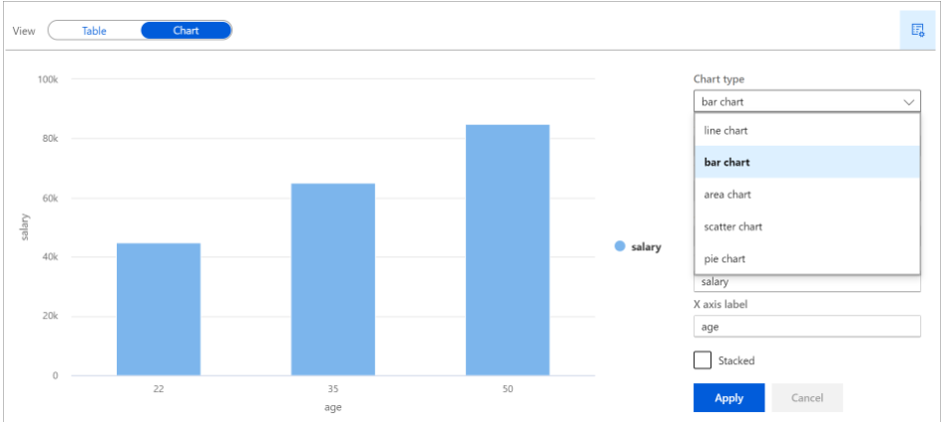
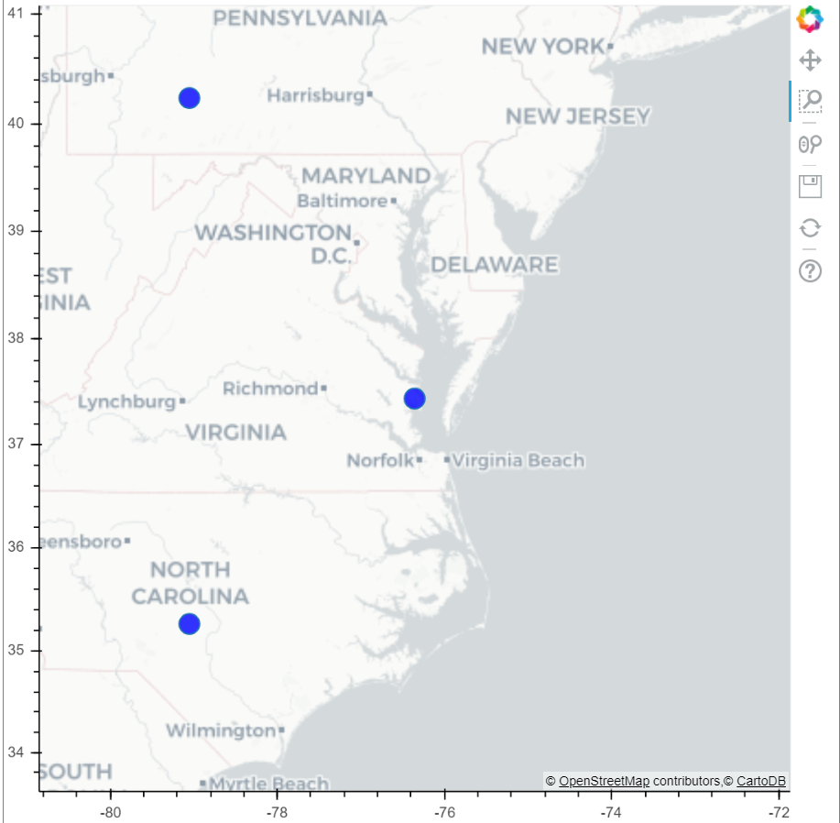
Development: Visualize data in a notebook
Display()
DisplayHTML()
Notes:
deeper

Slide 12
Machine Learning

Slide 13
Machine Learning in Azure Synapse Analytics
Azure Machine Learning Integration
support for connecting with Azure Machine Learning SDK to a workspace
Notes:
Day 03 – more advanced (add diagram Synapse->AzureML)

Slide 14
Using AutoML from Synapse Spark
Notes:
Add diagram (local/aml compute)

Slide 15
Thank You slide
Thank you

